Slide 1
Credit Card Fraud Detection
An Analysis and Model Deployment

Slide 2
Introduction
Credit card fraud is a significant and growing problem in the financial industry. It involves unauthorized use of a credit card to make purchases or withdraw funds. Fraudulent transactions can result in substantial financial losses for both consumers and financial institutions. As online transactions increase, so does the sophistication and frequency of fraudulent activities.
Detecting and preventing credit card fraud is, therefore, a critical task for financial institutions to protect their customers and maintain trust.

Slide 3
Data Overview
The dataset used for credit card fraud detection is sourced from Kaggle and contains transactions made by credit cards in September 2013 by European cardholders. This dataset presents transactions that occurred over two days, with 350 frauds out of 156897 transactions. The dataset is highly unbalanced, with the positive class (frauds) accounting for 0.172% of all transactions.
Overview of the Features
The dataset consists of 31 columns:
Time: The time elapsed between this transaction and the first transaction in the dataset (in seconds).
V1 to V28: The result of a Principal Component Analysis (PCA) transformation on the original features to protect user confidentiality. These components capture the most important variance in the dataset.
Amount: The transaction amount. This feature can be used to weigh fraudulent transactions differently from non-fraudulent ones.
Class: The target variable, where 1 represents a fraudulent transaction and 0 represents a legitimate transaction.

Slide 4
Steps for Data Preprocessing
1. Load the Data
First, load your dataset using pandas from Google Drive
2. Handle Missing Values
Check for missing values and handle them appropriately. In this example, we'll assume there are no missing values, but if there are, you might want to fill them in or drop the rows/columns:
3. Data Splitting
Split the data into training and testing sets using train_test_split from sklearn.model_selection:

Slide 5
Exploratory Data Analysis (EDA)
By performing these steps in EDA, you can gain a comprehensive understanding of the dataset, identify potential issues, and extract meaningful insights that guide subsequent modeling efforts. The visualizations provide a clear depiction of data distribution, correlations, and relationships between features and the target variable.
Class Imbalance: The dataset is highly imbalanced with only a small percentage of transactions being fraudulent.
Statistical Summary: Observing the mean, standard deviation, and quartiles of each feature can highlight differences between fraudulent and non-fraudulent transactions.
Correlation Analysis: Identifying which features are highly correlated can help in understanding the dataset better.

Slide 6
Model Training
1. Logistic Regression
Description of the Model: Logistic Regression is a linear model used for binary classification tasks. It estimates the probability that an instance belongs to a particular class.
Training Process:
Data Splitting: Split the data into training and testing sets.
Model Initialization: Create an instance of LogisticRegression with the liblinear solver.
Liblinear was selected as solver because it is particularly suited for binary classification problems
Hyperparameter Tuning: Use GridSearchCV to find the best value for the regularization parameter C.
Parameters Used:
C: Regularization strength (inverse of regularization coefficient). Often, a value of C=1 is used as a starting point because it provides a balance between underfitting and overfitting.

Slide 7
Model Training
2. Decision Tree
Description of the Model: A Decision Tree is a non-linear model that splits the data into subsets based on feature values, forming a tree structure.
Training Process:
Data Splitting: Split the data into training and testing sets.
Model Initialization: Create an instance of DecisionTreeClassifier with the entropy criterion.
Hyperparameter Tuning: Use GridSearchCV to find the best values for max_depth, min_samples_split, and min_samples_leaf.
Parameters Used:
max_depth: Maximum depth of the tree.
min_samples_split: Minimum number of samples required to split an internal node.
min_samples_leaf: Minimum number of samples required to be at a leaf node.

Slide 8
Model Training
3. Random Forest
Description of the Model: Random Forest is an ensemble method that uses multiple decision trees to improve classification accuracy and control over-fitting.
Training Process:
Data Splitting: Split the data into training and testing sets.
Model Initialization: Create an instance of RandomForestClassifier.
Hyperparameter Tuning: Use GridSearchCV to find the best values for n_estimators, max_depth, min_samples_split, and min_samples_leaf.
Parameters Used:
n_estimators: Number of trees in the forest.
max_depth: Maximum depth of the tree.
min_samples_split: Minimum number of samples required to split an internal node.
min_samples_leaf: Minimum number of samples required to be at a leaf node.

Slide 9
Model Training
4.XGBoost
Description of the Model: XGBoost is an efficient and scalable implementation of gradient boosting for decision trees.
Training Process:
Data Splitting: Split the data into training and testing sets.
Model Initialization: Create an instance of XGBClassifier.
Hyperparameter Tuning: Use GridSearchCV to find the best values for learning_rate, n_estimators, max_depth, min_child_weight, subsample, colsample_bytree, and gamma.
Parameters Used:
learning_rate: Step size shrinkage used to prevent overfitting.
n_estimators: Number of trees to fit.
max_depth: Maximum depth of the tree.
min_child_weight: Minimum sum of instance weight needed in a child.
gamma: Minimum loss reduction required to make a further partition on a leaf node.
subsample: Fraction of samples used for fitting the individual base learners.
colsample_bytree: Fraction of features used for fitting the individual base learners.

Slide 10
Model Training
Summary
Logistic Regression: Focused on finding the best regularization strength C.
Decision Tree: Tuned max_depth, min_samples_split, and min_samples_leaf.
Random Forest: Tuned n_estimators, max_depth, min_samples_split, and min_samples_leaf.
XGBoost: Tuned learning_rate, n_estimators, max_depth, min_child_weight, gamma, subsample, and colsample_bytree.
Hyperparameter tuning using GridSearchCV ensures that the models are optimized for better performance. The best parameters obtained from the grid search are then used to train the final model on the training dataset.

Slide 11
Model Evaluation
1. Performance Metrics for Each Model
To evaluate the performance of each model, we considered the following metrics:
Accuracy: The ratio of correctly predicted instances to the total instances.
2. Confusion Matrices
The confusion matrix provides insight into the types of errors the model is making. It consists of four components:
True Positives (TP): The number of correctly predicted positive cases.
True Negatives (TN): The number of correctly predicted negative cases.
False Positives (FP): The number of incorrectly predicted positive cases (Type I error).
False Negatives (FN): The number of incorrectly predicted negative cases (Type II error).
3. Classification Reports
The classification report includes precision, recall, and F1-score for each class (legitimate and fraudulent transactions).

Slide 12
Best Model Selection: Random Forest
Explanation of Why the Random Forest Model Was Chosen
The Random Forest model was chosen as the best model for the credit card fraud detection project due to its superior performance metrics, robustness to overfitting, scalability, and interpretability. Its high accuracy, precision, recall, and F1-score demonstrate its effectiveness in identifying fraudulent transactions while minimizing false positives and false negatives.
By leveraging Random Forests, we can achieve reliable and interpretable results, making it a valuable tool for real-world credit card fraud detection applications.

Slide 13
Deployment
1. Model Training and Saving:
Trained the Random Forest model on the training dataset.
Saved the trained model using joblib for later use in the web application.
2.Setting Up Streamlit Application:
Created a Streamlit application (app.py) to serve the model and allow users to input features and get predictions.
3. Setting Up Ngrok for Public Access:
Used Ngrok to create a secure tunnel to the Streamlit application, making it accessible over the internet.
4. Running the Application:
Executed the Python script to launch the Streamlit application and establish the Ngrok tunnel.
Link to the Web Application
The web application is hosted using Ngrok and can be accessed via the following URL:
Streamlit app is live at NgrokTunnel: "https://8865-34-45-116-219.ngrok-free.app" -> "http://localhost:8501”

Slide 14
Difficulties
Lot of difficulties were faced while the execution of this project and some of the prime
Difficulties are listed below.
Hyperparameter Tuning: Finding the optimal hyper parameters for the chosen model requires extensive experimentation and cross-validation, which is computationally intensive. For eg. For Random forest hyper parameter tuning, the computation was taking lot of time of more than 12 hours in colab . And hence colab runtime was disconnecting even before the execution completes. And then execution had to restart again multiple times.
The issue was finally solved by performing the Hyper parameter tuning part locally in laptop using the Jupyter note. Since it was done locally, the timeout issue found in colab was solved

Slide 15
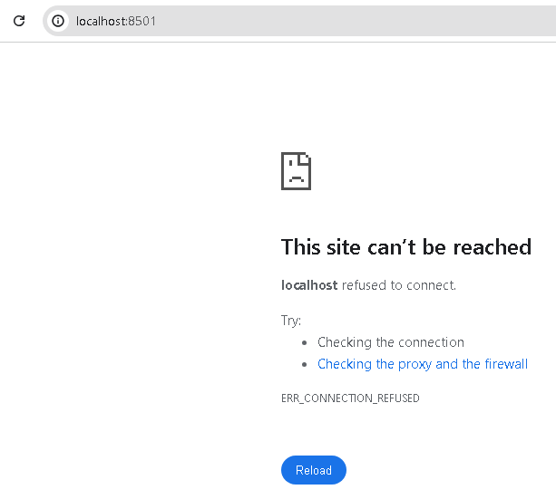
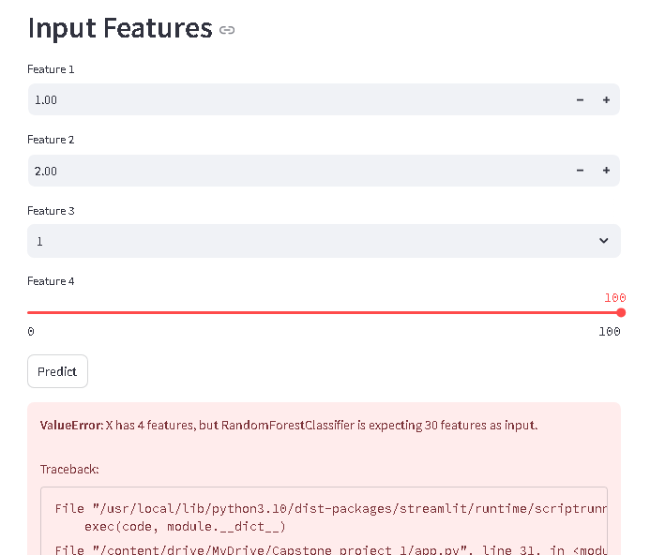
Difficulties
2. Deployment: During deployment , the streamlit app was giving multiple issues.
1) Initially link was not working and the page was not loading
2) Incomplete Interface was visible as complete feature were not available as in below
image.

Slide 16
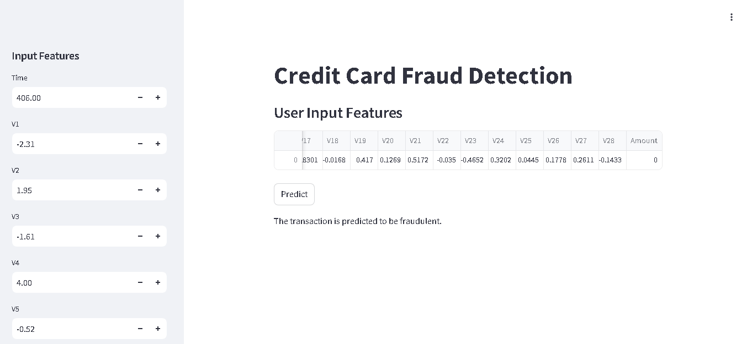
Difficulties
On repeated validation, finally it was observed that the older App was using in colab notebook. It was changed and finally the APP was performing as it was intended.
Final Output

Slide 17
THANKS

